Slide 1
Frontend project- Bake my Cake

Slide 2
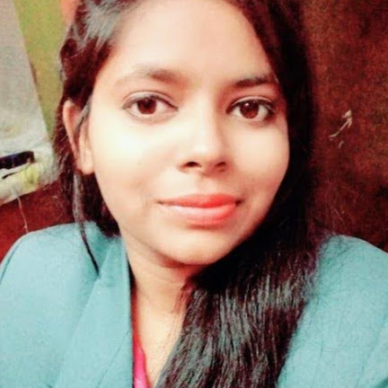
Introduction NAME : SAUMYA PATEL QUALIFICATION: B-TECH in Electrical Engineering TECHNOLOGIES LEARNT : HTML, CSS, JAVASCRIPT, ANGULAR, JAVA

Slide 3
Problem statement
Bake My Cake, that allows customers to make an online request for cakes, cookies, or brownies of their choice
The app can search and filter the items by the user’s preference for a quick selection.
The app should seek confirmation from the users before allowing them to navigate away from the order view without submitting the details.​
The site administrator can view the incoming order requests.​ The app should redirect user to first validate his identity as site administrator before providing access to the order request view.​

Slide 4
Technologies used in project
HTML,CSS,TYPESCRIPT,JSON-Server ,Angular framework

Slide 5
Component hierarchy
App-component
baker-manager-component
Search component
Filter component
header
baker-list
Baker-card
footer

Slide 6
Routing between component
Baker-manager(home-view)
order-view component
baker-request(admin)
page -not-found (for pages not defined)
Baker-manager(home-view)

Slide 7
Baker manager component
Baker manager component is a landing view
It display all the images of bakery product
It also provide option to search and filter the item on basis of name and categories respectively
On clicking order button it will navigate us to order-view

Slide 8
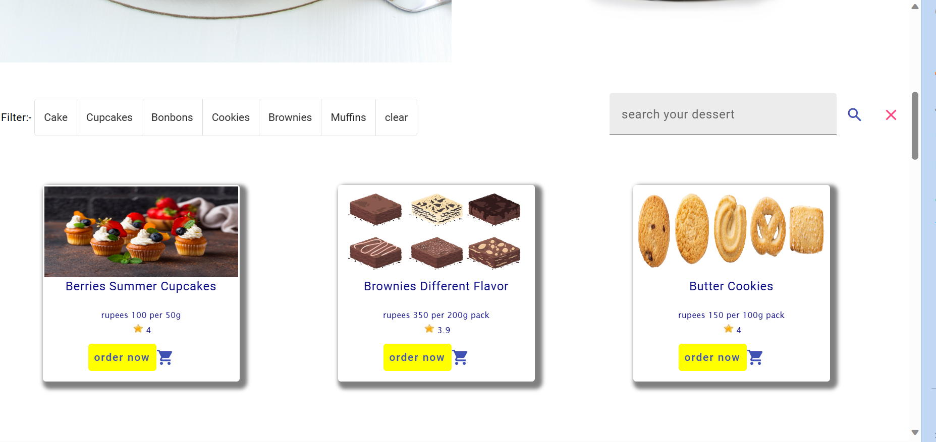
Filter -component
Search-component
Card list for display image

Slide 9
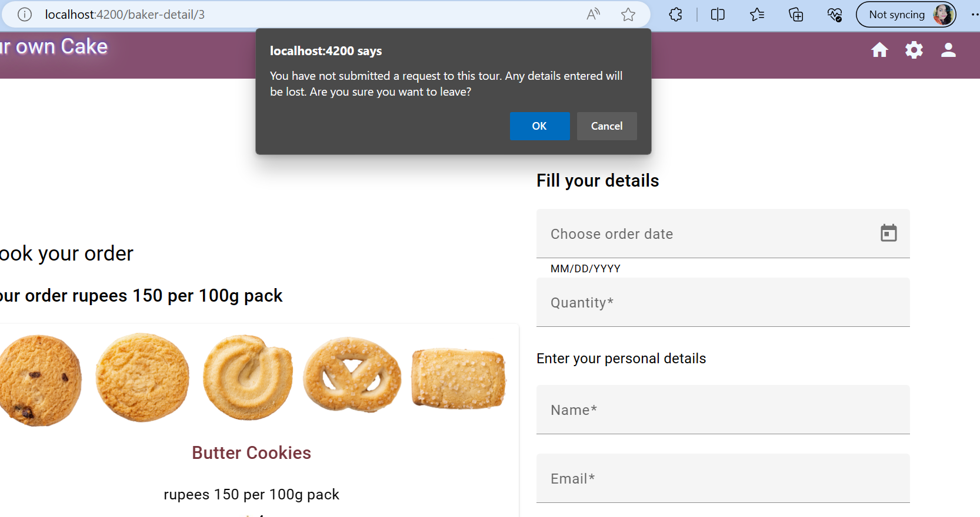
Order view component
The view should display the details of the item selected
This view should also allow user to provide the details required for placing order for the selected item.
The app will request confirmation from the user to leave the view, if the user attempts to navigate away from this view without submitting the request.

Slide 10
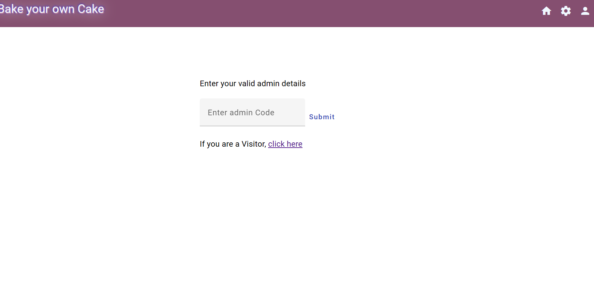
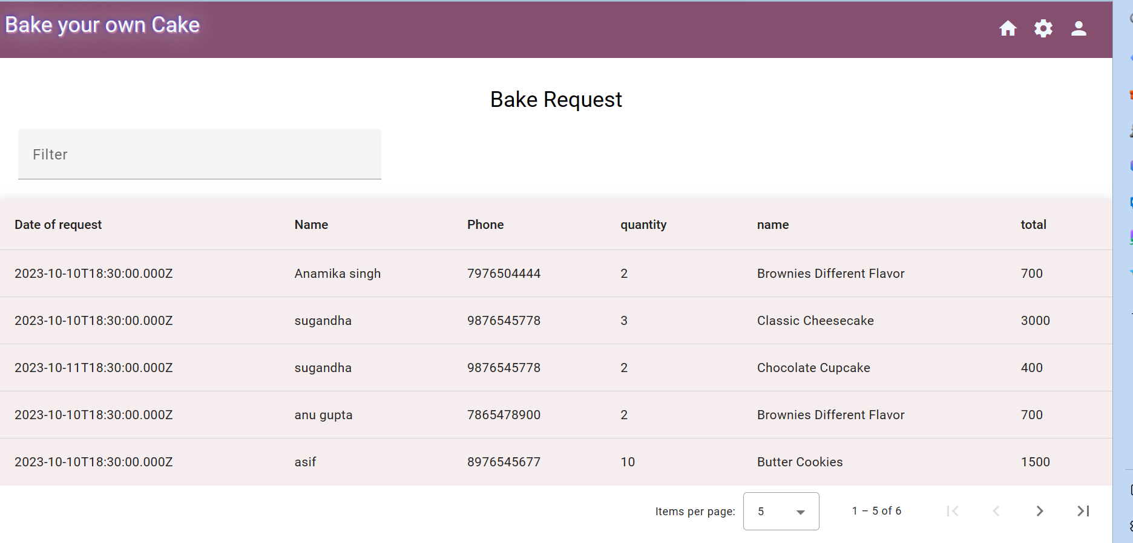
The login-view and bake request
Login –view allow only restricted access to bake request page
The bake request view will display all the cake order requests received in tabular format.

Slide 11
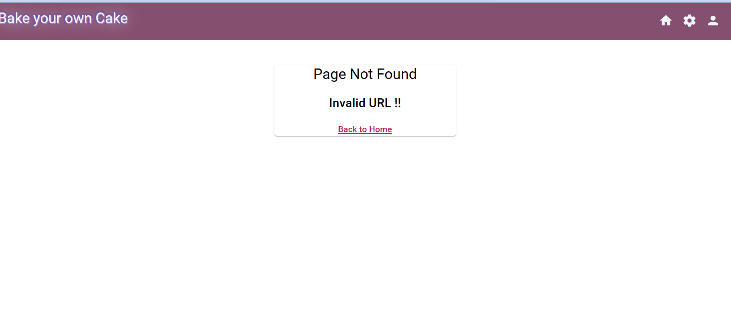
Page not found
It appears when user enter incorrect address or id

Slide 12
Future enhancement
Enhanced user experience: This could involve adding new features, improving the design, or making the website or application more responsive.
Like Quantity , size can also be customized
Instead of going to home page after request submission payment gateway UI can be added .

Slide 13
Thank You

